Slide 1
z
L_{CM}
L
CM
x
y
d

Slide 3
P
O
Axis
P
O
Axis

Slide 4
Line of action of force
P
d
O
Axis
P
O
Axis

Slide 5
P
O
Line of action of net force
Axis
L
Axis

Slide 8
Straight line
O
O
O
O

Slide 9
O

Slide 10
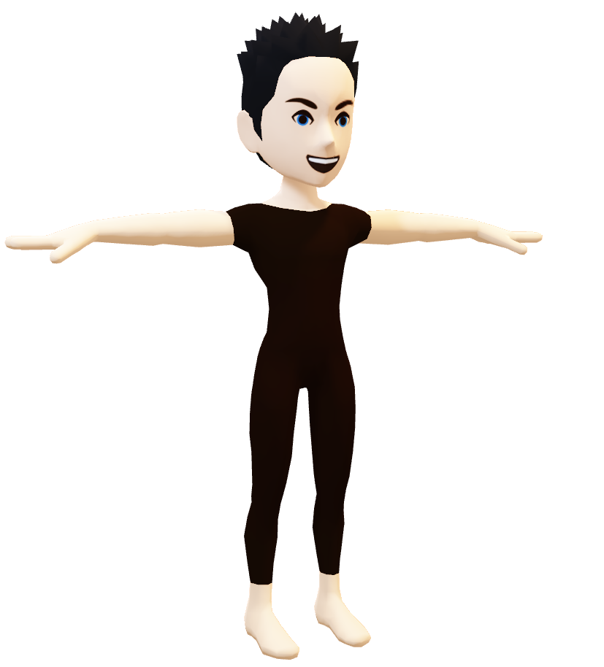

Slide 11


